Slide 1

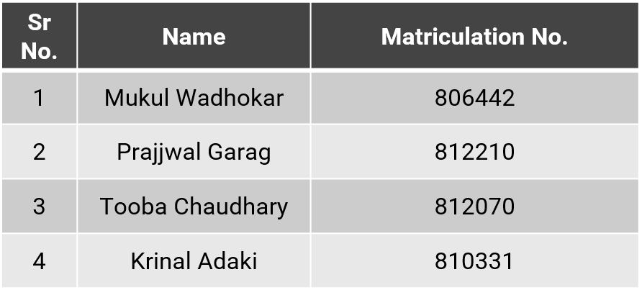

MEET THE TEAM
Case Study : Pressure Cooker Lid
Lecturer: Prof. Paulo Pecas
MEET THE TEAM
Case Study : Pressure Cooker Lid
Lecturer: Prof. Paulo Pecas
Group 4
Life Cycle Engineeing Case Study : Pressure Cooker Lid
Guided by - Prof. Dr. Paulo Pecas
M.Sc. Advanced Manufacturing Course
Technische Universität Chemnitz
July 2024
TU Chemnitz · Summer Term-2024 · GROUP-4 · Pressure Cooker Lid
LIFE CYCLE ENGINEERING · ADV MANUF
1

Slide 2




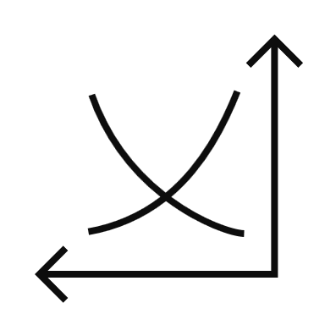
CONTENTS
Case Study : Pressure Cooker Lid
Lecturer: Prof. Paulo Pecas
PRODUCT PITCH
MARKET RESEARCH
MACHINE CALCULATION
COST ANALYSIS
SENSITIVITY ANALYSIS
01.
02.
03.
04.
05.
TU Chemnitz · Summer Term-2024 · GROUP-4 · Pressure Cooker Lid
LIFE CYCLE ENGINEERING · ADV MANUF
2

Slide 3
CONTENTS
Case Study : Pressure Cooker Lid
Lecturer: Prof. Paulo Pecas
LIFE CYCLE IMPACT ANALYSIS
FUNCTIONAL ASSESSMENT
USE PHASE ANALYSIS
TERNARY DIAGRAM
SUMMARY
06.
07.
08.
09.
10.
TU Chemnitz · Summer Term-2024 · GROUP-4 · Pressure Cooker Lid
LIFE CYCLE ENGINEERING · ADV MANUF
3

Slide 4
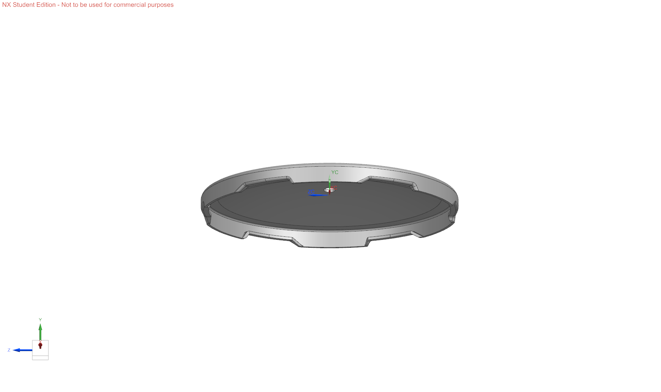
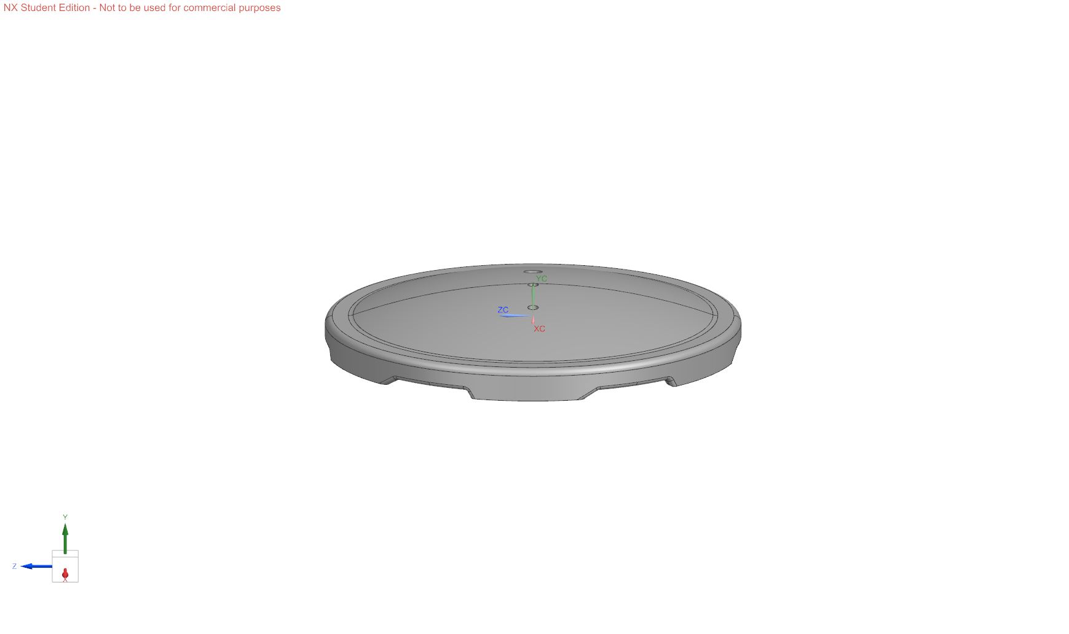
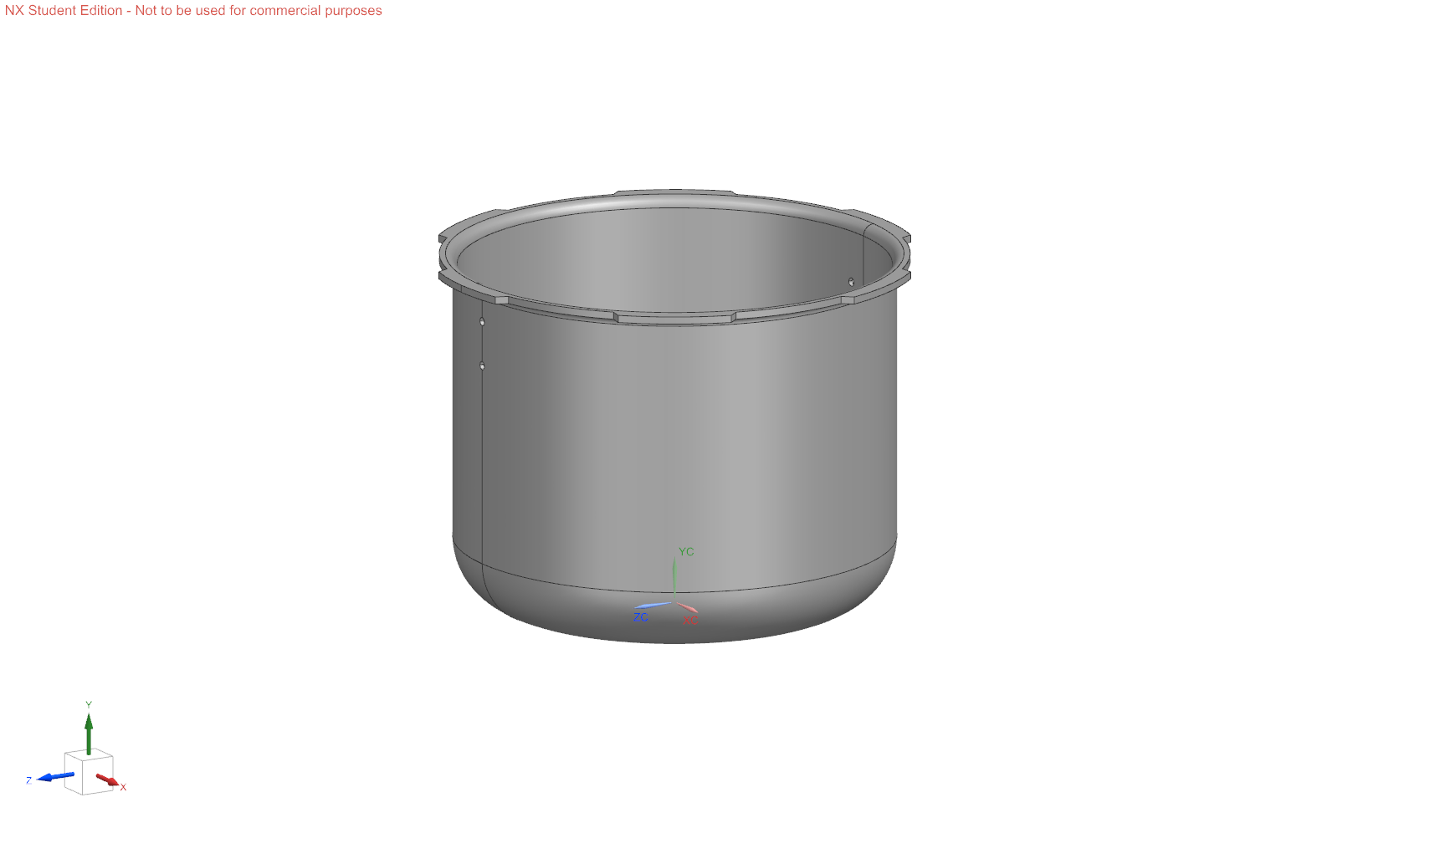
PRODUCT PITCH
Case Study : Pressure Cooker Lid
Lecturer: Prof. Paulo Pecas
Selected Product
TU Chemnitz · Summer Term-2024 · GROUP-4 · Pressure Cooker Lid
LIFE CYCLE ENGINEERING · ADV MANUF
4

Slide 5
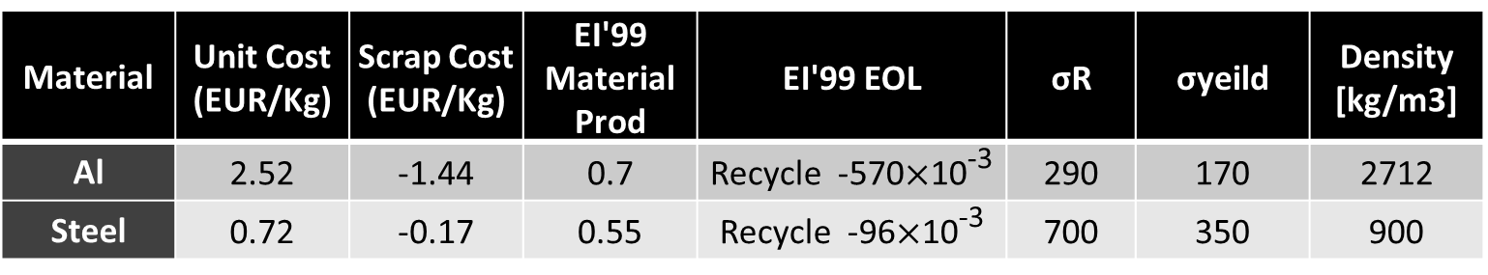
PRODUCT PITCH
Case Study : Pressure Cooker Lid
Lecturer: Prof. Paulo Pecas
Projected Surface Area
Material | Unit Cost (EUR/Kg) | Scrap Cost (EUR/Kg) | EI'99 Material Prod | EI'99 EOL | σR | σyeild | Density [kg/m3]
Al | 2.52 | -1.44 | 0.7 | Recycle -570$×$10⁻³ | 290 | 170 | 2712
Steel | 0.72 | -0.17 | 0.55 | Recycle -96$×$10⁻³ | 700 | 350 | 900
Material | Steel
Surface Area | 178000 mm2
Projected Area | 80777 mm2
Thickness | 1 mm
Production Type | Blanking and Stamping
Total Material Required(per year) | 8424323.625 Kg
Material | Aluminium
Surface Area | 186000 mm2
Projected Area | 80777 mm2
Thickness | 2.6 mm
Production Type | Blanking and Stamping
Total Material Required(per year) | 6690061.823 Kg
TU Chemnitz · Summer Term-2024 · GROUP-4 · Pressure Cooker Lid
LIFE CYCLE ENGINEERING · ADV MANUF
5

Slide 6
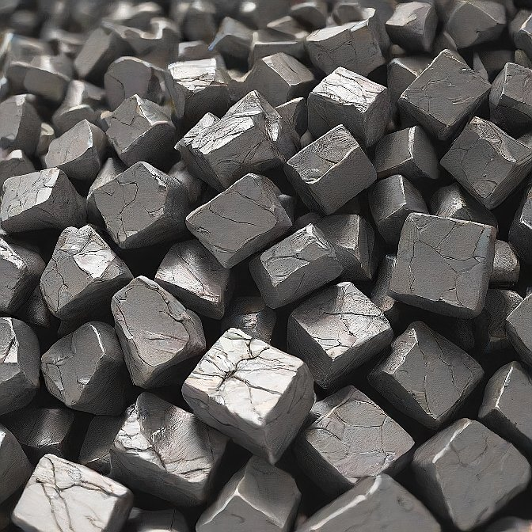
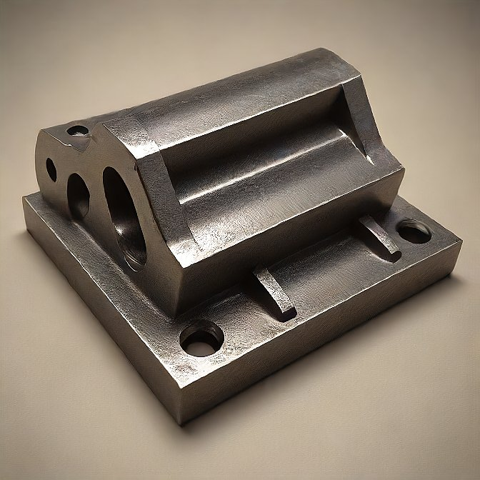
Reduce presentation size
MATERIAL COMPARISON
Case Study : Pressure Cooker Lid
Lecturer: Prof. Paulo Pecas
Aluminum
Steel
TU Chemnitz · Summer Term-2024 · GROUP-4 · Pressure Cooker Lid
LIFE CYCLE ENGINEERING · ADV MANUF
6

Slide 7

COMPARISON OF FEATURES
Case Study : Pressure Cooker Lid
Lecturer: Prof. Paulo Pecas
Durability
Stainless steel pressure cookers are generally more durable, resistant to scratches, dents, and corrosion and long-lasting than their aluminum counterparts, which can be prone to denting and warping over time.
Heat Conductivity
Aluminum pressure cookers heat up quickly and evenly resulting into and therefore, lesser fuel consumption, while stainless steel may take a bit longer to reach the desired temperature.
Maintenance
Stainless steel pressure cookers are easier to clean and maintain, with a smooth, non-porous surface that resists staining and odors. Aluminum can be more prone to discoloration and stains.
Aluminum VS Steel
TU Chemnitz · Summer Term-2024 · GROUP-4 · Pressure Cooker Lid
LIFE CYCLE ENGINEERING · ADV MANUF
7

Slide 8
COMPARISON OF FEATURES
Case Study : Pressure Cooker Lid
Lecturer: Prof. Paulo Pecas
. Stainless Steel
Cost
Aluminium pressure cookers are generally more affordable than their steel counterparts, but their longevity often make them a cost-effective choice in the long run.
Lightweight and Portable
Aluminum pressure cookers are known for their lightweight and portable design, making them easy to move around the kitchen or even take with you when traveling.
TU Chemnitz · Summer Term-2024 · GROUP-4 · Pressure Cooker Lid
LIFE CYCLE ENGINEERING · ADV MANUF
8

Slide 9
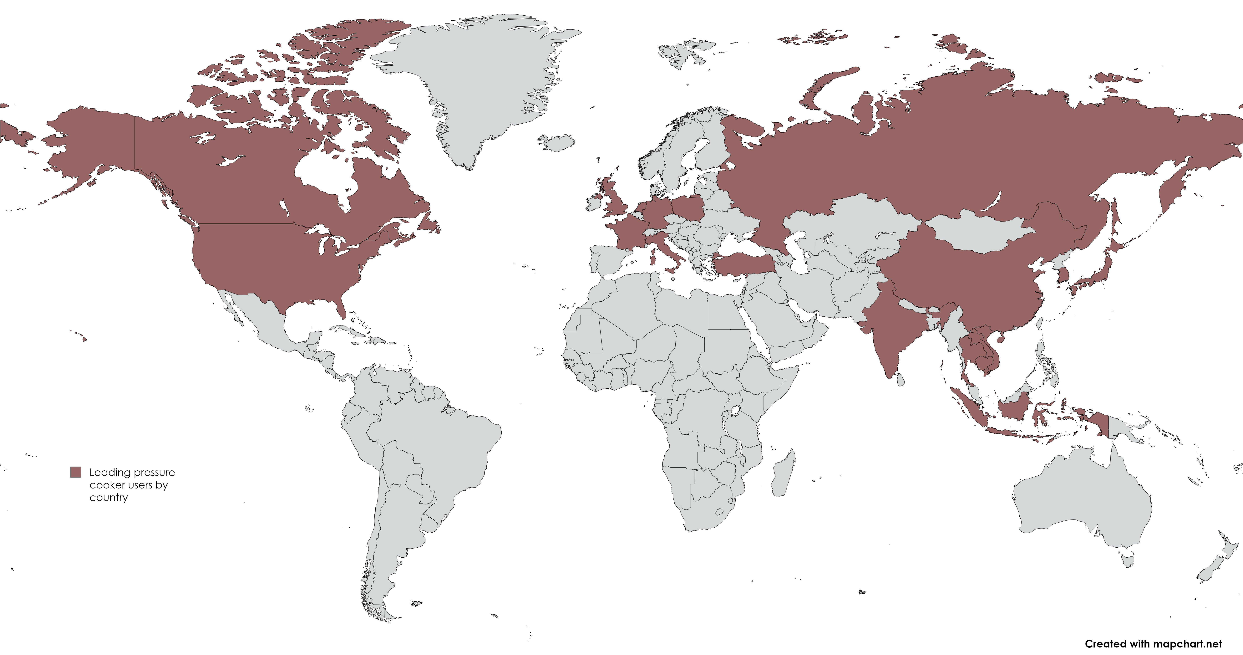
EFFECTIVE PRODUCTION VOL.
Case Study : Pressure Cooker Lid
Lecturer: Prof. Paulo Pecas
Sales volume of Pressure cookers in European market 34 million Nos per year.
Aluminum - 40% of the overall pressure cooker market in Europe. 13.6 million
Steel - 60% of the overall pressure cooker market in Europe. 20.4 million
We are targeting 10 million Nos. of market share of both Steel and Aluminum
Material | Average Price (EUR)
Aluminum | € 3
Steel | € 2
Source: Fortunebuissnessinsights.com
TU Chemnitz · Summer Term-2024 · GROUP-4 · Pressure Cooker Lid
LIFE CYCLE ENGINEERING · ADV MANUF
9

Slide 10
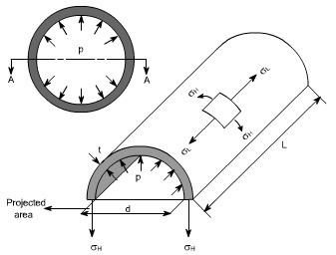
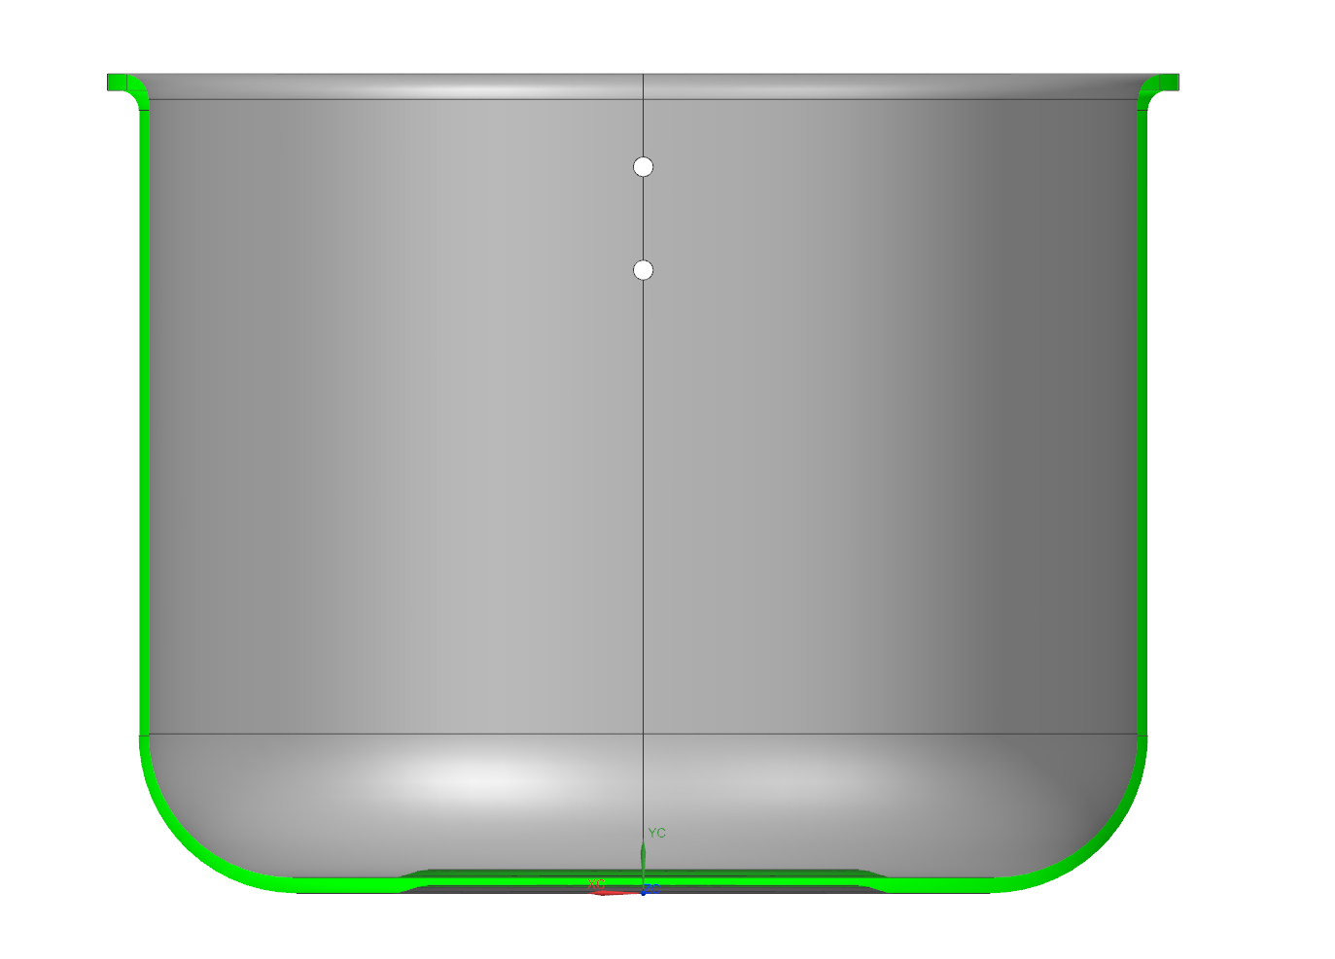
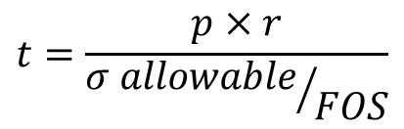
EFFECTIVE PRODUCTION VOL.
Case Study : Pressure Cooker Lid
Lecturer: Prof. Paulo Pecas
Thickness Definition
Using Hoop Stress Formula:
$$t=\frac{p×r}{{σ allowable}/{FOS}}$$
P=1.2 atm/ 0.1214 Mpa
r= 0.15m,
Steel
Aluminum
t ≈ 1 mm
t ≈ 2.6 mm
For Practical purposes, durability and manufacturing feasibility the min thickness for steel 1mm is more reasonable for such application which leads to FOS of 13.5.
1 mm
2.6 mm
TU Chemnitz · Summer Term-2024 · GROUP-4 · Pressure Cooker Lid
LIFE CYCLE ENGINEERING · ADV MANUF
10

Slide 11
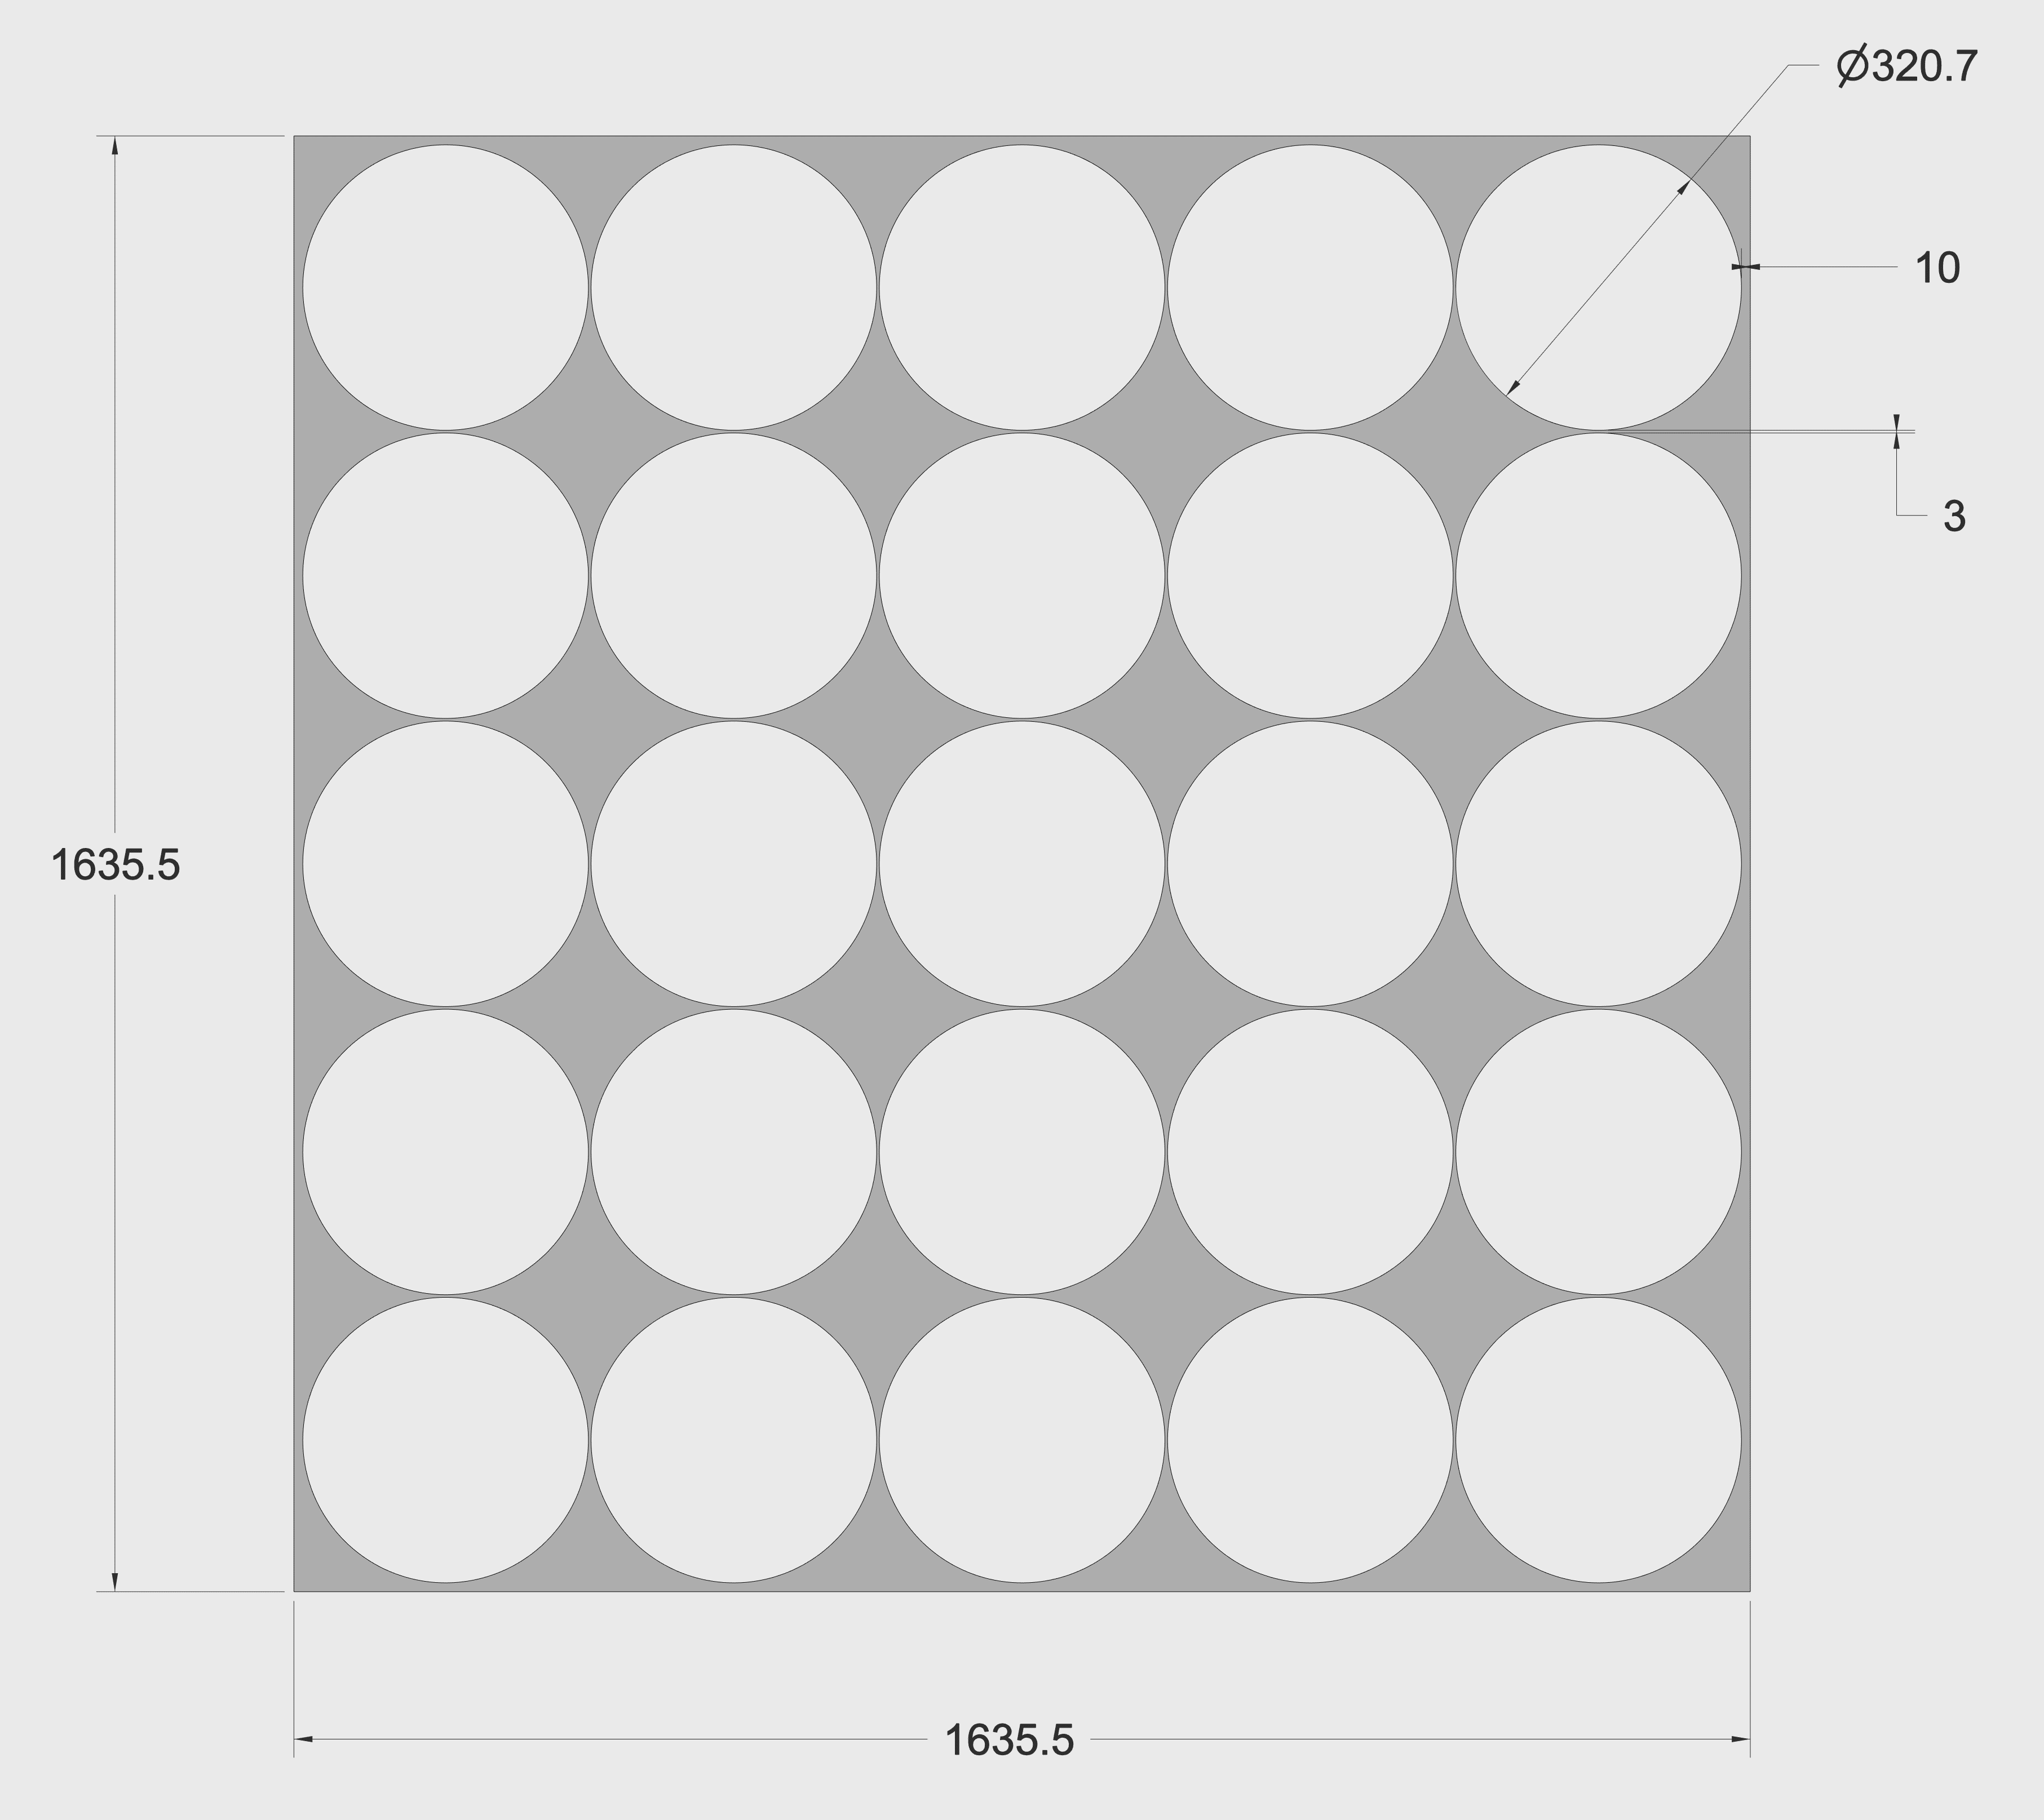
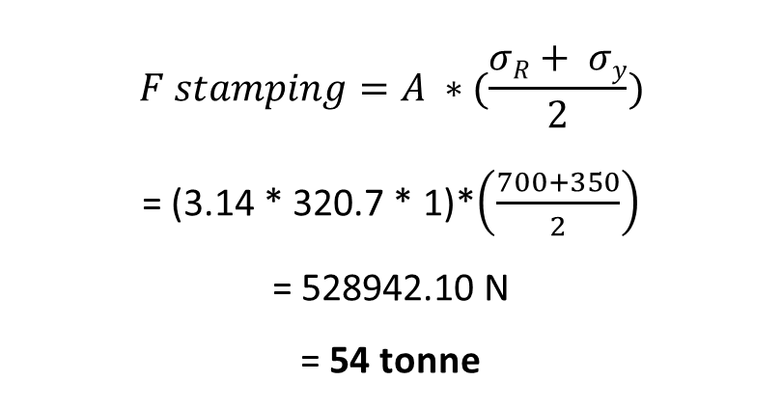
EFFECTIVE PRODUCTION VOL.
Case Study : Pressure Cooker Lid
Lecturer: Prof. Paulo Pecas
Steel
D = 320.7 mm
T = 1 mm
$$F stamping=A ∗(\frac{σR+ σy}{2})$$
= (3.14 * 320.7 * 1)*$\left(\frac{700+350}{2}\right)$
= 528942.10 N
= 54 tonne
No. of parts to stamp in 1 sheet 25 Nos, (5x5)
TU Chemnitz · Summer Term-2024 · GROUP-4 · Pressure Cooker Lid
LIFE CYCLE ENGINEERING · ADV MANUF
11

Slide 12
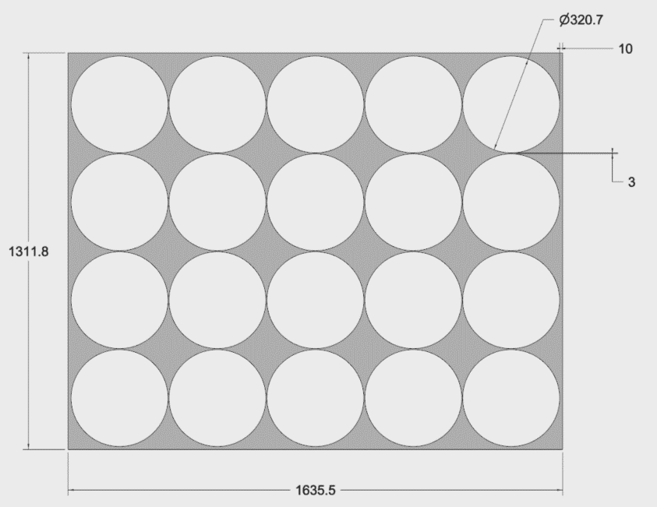
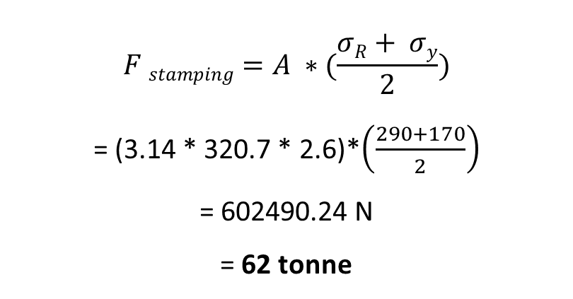
EFFECTIVE PRODUCTION VOL.
Case Study : Pressure Cooker Lid
Lecturer: Prof. Paulo Pecas
Aluminum
D = 320.7 mm
T = 2.6 mm
$$F stamping=A ∗(\frac{σR+ σy}{2})$$
= (3.14 * 320.7 * 2.6)*$\left(\frac{290+170}{2}\right)$
= 602490.24 N
= 62 tonne
No. of parts to stamp in 1 sheet 20 Nos, (4x5)
TU Chemnitz · Summer Term-2024 · GROUP-4 · Pressure Cooker Lid
LIFE CYCLE ENGINEERING · ADV MANUF
12

Slide 13
EFFECTIVE PRODUCTION VOL.
Case Study : Pressure Cooker Lid
Lecturer: Prof. Paulo Pecas
Effective PRODUCTION VOLUME
Target Production Volume
10,000,000
STAMPING
Effective Production Volume
10,025,063
Blanking
Effective Production Volume
10,030,078
PROCESS
PROCESS
REJECTION = 0.25%
REJECTION = 0.05%
TOOL COST CALCULATION
Tool Cost = A * (nr hits)^{B} $×$ (Surf Area/Proj Area)^{C} $×$ (Part Width*Part Length)^{D}
Tool Cost = A * (nr hits)^{B} $×$ (Surf Area/Proj Area)^{C} $×$ (Part Width*Part Length)^{D}
= 1567 x (4)^{1.366} x (73/18.68)^{0.323} x (64 x 124.160)^{0.342}
= 1567 x (4)^{1.366} x (73/18.68)^{0.323} x (64 x 124.160)^{0.342}
= 25,241 Euros
= 25,602 Euros
TU Chemnitz · Summer Term-2024 · GROUP-4 · Pressure Cooker Lid
LIFE CYCLE ENGINEERING · ADV MANUF
13

Slide 14
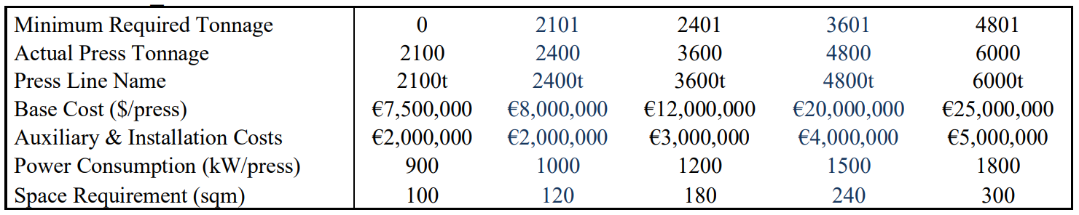
UNIT COST ANALYSIS
Case Study : Pressure Cooker Lid
Lecturer: Prof. Paulo Pecas
Selection of Stamping Machine (Steel and Aluminum)
Steel
Total force = F _{(for 1 part)} x No. of Parts
= 54 x 25
= 1350 Tonne
Which is lower << 2100 Machine No.1,
Therefore machine 1 is selected.
Aluminum
Total force = F _{(for 1 part)} x No. of Parts
= 60 x 20
= 1200 Tonne
Which is lower << 2100 Machine No.1,
Therefore machine 1 is selected.
TU Chemnitz · Summer Term-2024 · GROUP-4 · Pressure Cooker Lid
LIFE CYCLE ENGINEERING · ADV MANUF
14

Slide 15
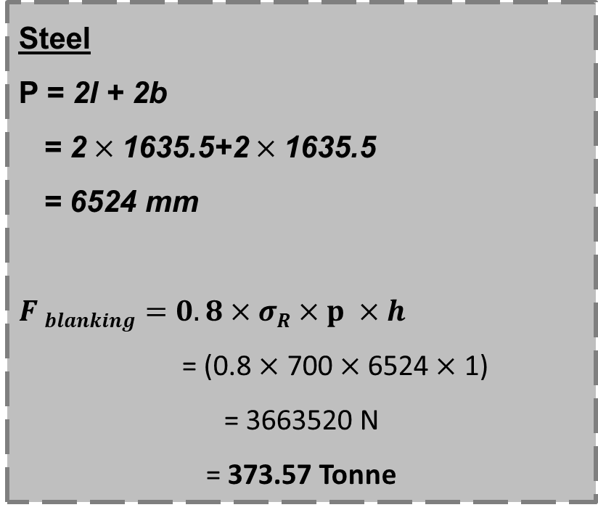
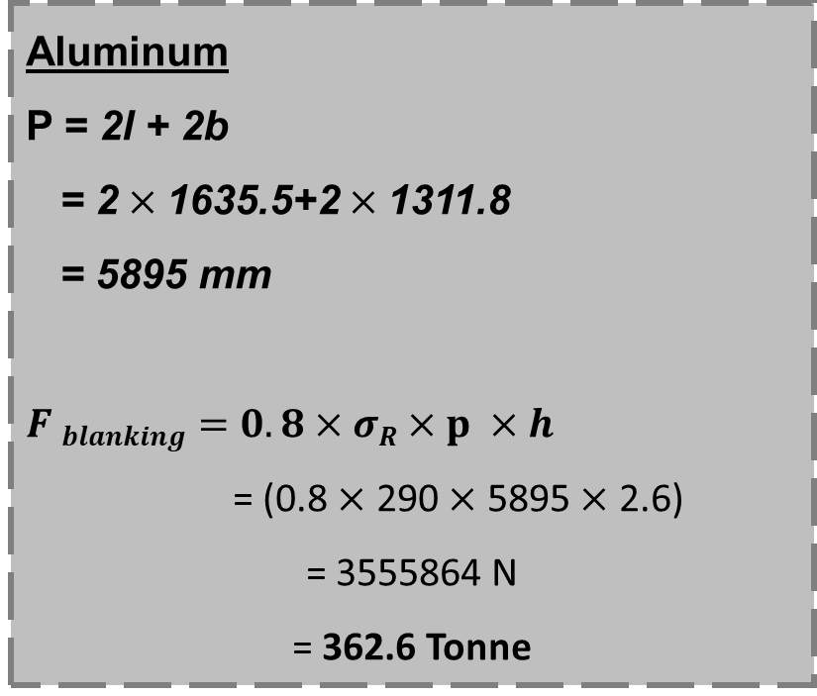
UNIT COST ANALYSIS
Case Study : Pressure Cooker Lid
Lecturer: Prof. Paulo Pecas
Steel and Aluminum
Steel
P = 2l + 2b
= 2 $×$1635.5+2 $×$1635.5
= 6524 mm
$F blanking=0.8×$ $σR×p ×h$
= (0.8 $×$ 700 $×$6524 $×$ 1)
= 3663520 N
= 373.57 Tonne
Aluminum
P = 2l + 2b
= 2 $×$1635.5+2 $×$1311.8
= 5895 mm
$F blanking=0.8×$ $σR×p ×h$
= (0.8 $×$ 290 $×$ 5895 $×$ 2.6)
= 3555864 N
= 362.6 Tonne
TU Chemnitz · Summer Term-2024 · GROUP-4 · Pressure Cooker Lid
LIFE CYCLE ENGINEERING · ADV MANUF
15

Slide 16
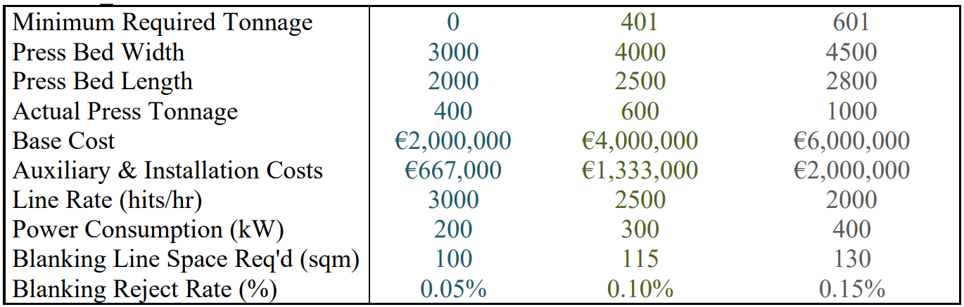
UNIT COST ANALYSIS
Case Study : Pressure Cooker Lid
Lecturer: Prof. Paulo Pecas
Selection of Blanking Machine
Based on the blanking calculation total required force for Steel is 373.57 Tonne and for Aluminum is 362.6 Tonne
So Machine 1 is selected.
TU Chemnitz · Summer Term-2024 · GROUP-4 · Pressure Cooker Lid
LIFE CYCLE ENGINEERING · ADV MANUF
16

Slide 17
COST ANALYSIS
Case Study : Pressure Cooker Lid
Lecturer: Prof. Paulo Pecas
Steel
Variable Cost | Unit Cost | Per Year | Percent
Material Cost | € 0.605 | € 60,65,513 | 61.9%
Energy Cost | € 0.009 | € 91,296 | 0.93%
Labour Cost | € 0.003 | € 27,440 | 0.28%
Total Variable Cost | € 0.617 | € 61,84,249 | 63%
Fixed Cost | Unit Cost | Per Year | Percent
Main Machine Cost+Interest | € 0.189 | € 18,92,895 | 19%
Auxiliary Equipment Cost | € 0.053 | € 5,31,405 | 5%
Tooling Cost | € 0.003 | € 25,241 | 0%
Fixed Overhead | € 0.087 | € 8,73,331 | 9%
Building Cost | € 0.005 | € 45,690 | 0%
Maintenance Cost | € 0.025 | € 2,49,523 | 3%
Total Fixed Cost | € 0.362 | € 36,18,085 | 37%
Total Cost | € 0.978 | € 98,02,335 | 100%
TU Chemnitz · Summer Term-2024 · GROUP-4 · Pressure Cooker Lid
LIFE CYCLE ENGINEERING · ADV MANUF
17

Slide 18
COST ANALYSIS
Case Study : Pressure Cooker Lid
Lecturer: Prof. Paulo Pecas
Aluminum
Variable Cost | Unit Cost | Per Year | Percent
Material Cost | € 1.681 | € 1,68,58,956 | 81.7%
Energy Cost | € 0.011 | € 1,12,783 | 0.55%
Labour Cost | € 0.003 | € 34,300 | 0.17%
Total Variable Cost | € 1.696 | € 1,70,06,039 | 82%
Fixed Cost | Unit Cost | Per Year | Percent
Main Machine Cost+interest | € 0.189 | € 18,92,895 | 9%
Auxiliary Equipment Cost | € 0.053 | € 5,31,405 | 3%
Tooling Cost | € 0.003 | € 25,602 | 0%
Fixed Overhead | € 0.087 | € 8,73,457 | 4%
Building Cost | € 0.005 | € 45,690 | 0%
Maintenance Cost | € 0.025 | € 2,49,559 | 1%
Total Fixed Cost | € 0.362 | € 36,18,609 | 18%
Total Cost | € 2.057 | € 2,06,24,648 | 100%
TU Chemnitz · Summer Term-2024 · GROUP-4 · Pressure Cooker Lid
LIFE CYCLE ENGINEERING · ADV MANUF
18

Slide 19
COST ANALYSIS
Case Study : Pressure Cooker Lid
Lecturer: Prof. Paulo Pecas
UNIT COST = FIXED COST/UNIT + VARIABLE COST/UNIT
Variable Cost/Unit = Material Cost + Energy Cost + Labour Cost
Effective Production Volume
Fixed Cost/Unit = Machine Cost + Auxiliary & Installation Cost + Tool Cost + Building Cost
Effective Production Volume
Material | Energy Cost | Material Cost | Labour cost | Variable Cost/Unit | Fixed Cost/Unit | Total Cost/Unit
Steel | € 91,296 | € 6,065,513 | € 27,440 | € 0.617 | € 0.349 | € 0.978
Aluminum | € 112,374 | € 16,858,956 | € 33,279 | € 1.695 | € 0.349 | € 2.045
TU Chemnitz · Summer Term-2024 · GROUP-4 · Pressure Cooker Lid
LIFE CYCLE ENGINEERING · ADV MANUF
19

Slide 20
VARIATION OF TOTAL COSTS
Case Study : Pressure Cooker Lid
Lecturer: Prof. Paulo Pecas
Aluminum has higher total costs compared to steel at all production volumes, primarily due to higher variable costs.
TU Chemnitz · Summer Term-2024 · GROUP-4 · Pressure Cooker Lid
LIFE CYCLE ENGINEERING · ADV MANUF
20

Slide 21
SENSITIVITY ANALYSIS
Case Study : Pressure Cooker Lid
Lecturer: Prof. Paulo Pecas
Volume(millions) | Variable | Fixed | Total | No. of Stamping Machine(s)
5 | € 0.62 | 0.72 | 1.34 | 1
10 | € 0.62 | 0.36 | 0.98 | 1
15 | € 0.62 | 0.39 | 1.02 | 2
20 | € 0.62 | 0.29 | 0.92 | 2
25 | € 0.62 | 0.23 | 0.86 | 2
30 | € 0.62 | 0.27 | 0.90 | 3
35 | € 0.62 | 0.23 | 0.87 | 3
40 | € 0.62 | 0.20 | 0.84 | 3
45 | € 0.62 | 0.23 | 0.87 | 4
50 | € 0.62 | 0.21 | 0.85 | 4
55 | € 0.62 | 0.23 | 0.88 | 5
60 | € 0.62 | 0.21 | 0.86 | 5
65 | € 0.62 | 0.19 | 0.85 | 5
70 | € 0.62 | 0.21 | 0.87 | 6
75 | € 0.62 | 0.20 | 0.86 | 6
80 | € 0.62 | 0.19 | 0.85 | 6
85 | € 0.62 | 0.20 | 0.87 | 7
90 | € 0.62 | 0.19 | 0.86 | 7
95 | € 0.62 | 0.18 | 0.85 | 7
100 | € 0.62 | 0.19 | 0.87 | 8
105 | € 0.62 | 0.18 | 0.86 | 8
110 | € 0.62 | 0.20 | 0.88 | 9
115 | € 0.62 | 0.19 | 0.87 | 9
120 | € 0.62 | 0.18 | 0.87 | 9
100 Data points
TU Chemnitz · Summer Term-2024 · GROUP-4 · Pressure Cooker Lid
LIFE CYCLE ENGINEERING · ADV MANUF
21

Slide 22
SENSITIVITY ANALYSIS
Case Study : Pressure Cooker Lid
Lecturer: Prof. Paulo Pecas
Volume(millions) | Variable | Fixed | Total | No. of Stamping Machine(s)
5 | € 1.70 | € 0.72 | € 2.42 | 1
10 | € 1.70 | € 0.36 | € 2.06 | 1
15 | € 1.70 | € 0.39 | € 2.10 | 2
20 | € 1.70 | € 0.29 | € 2.00 | 2
25 | € 1.70 | € 0.32 | € 2.04 | 3
30 | € 1.70 | € 0.27 | € 1.99 | 3
35 | € 1.70 | € 0.30 | € 2.02 | 4
40 | € 1.70 | € 0.26 | € 1.99 | 4
45 | € 1.70 | € 0.28 | € 2.02 | 5
50 | € 1.70 | € 0.25 | € 1.99 | 5
55 | € 1.70 | € 0.27 | € 2.02 | 6
60 | € 1.70 | € 0.25 | € 2.00 | 6
65 | € 1.70 | € 0.23 | € 1.98 | 6
70 | € 1.70 | € 0.24 | € 2.01 | 7
75 | € 1.70 | € 0.23 | € 1.99 | 7
80 | € 1.70 | € 0.24 | € 2.01 | 8
85 | € 1.70 | € 0.23 | € 2.00 | 8
90 | € 1.70 | € 0.24 | € 2.02 | 9
95 | € 1.70 | € 0.23 | € 2.01 | 9
100 | € 1.70 | € 0.24 | € 2.03 | 10
105 | € 1.70 | € 0.23 | € 2.03 | 10
110 | € 1.70 | € 0.24 | € 2.05 | 11
115 | € 1.70 | € 0.23 | € 2.04 | 11
120 | € 1.70 | € 0.24 | € 2.06 | 12
100 Data points
TU Chemnitz · Summer Term-2024 · GROUP-4 · Pressure Cooker Lid
LIFE CYCLE ENGINEERING · ADV MANUF
22

Slide 23
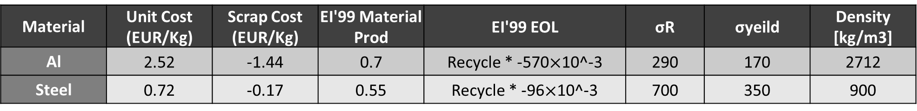
LIFE CYCLE IMPACT ANALYSIS
Case Study : Pressure Cooker Lid
Lecturer: Prof. Paulo Pecas
Life Cycle Assessment (Steel)
Material | Unit Cost (EUR/Kg) | Scrap Cost (EUR/Kg) | EI'99 Material Prod | EI'99 EOL | σR | σyeild | Density [kg/m3]
Al | 2.52 | -1.44 | 0.7 | Recycle * -570$×$10^-3 | 290 | 170 | 2712
Steel | 0.72 | -0.17 | 0.55 | Recycle * -96$×$10^-3 | 700 | 350 | 900
Production Phase
Parameter | Tons | Environmental Impact (pts/Kg) | Points
Material | 8399.06 | 0.55 | 4619.48
Scrap(Recycled) | 1449.06 | -0.17 | -246.34
Total |  |  | 4373.14
Energy Consumption Impact
Pameter | KWh | Environmental Impact (pts/Kg) | Points
Energy Consumption | 1141199.95 | 0.5 | 570599.98
End Of Life
Pameter | Tons | Environmental Impact (pts/Kg) | Points
Product(Recycle) | 6950 | -0.096 | -667.2
Total Environmental Impact | 3705.94 |  | Pts
TU Chemnitz · Summer Term-2024 · GROUP-4 · Pressure Cooker Lid
LIFE CYCLE ENGINEERING · ADV MANUF
26

Slide 24
LIFE CYCLE IMPACT ANALYSIS
Case Study : Pressure Cooker Lid
Lecturer: Prof. Paulo Pecas
Life Cycle Assessment (Aluminum)
Material | Unit Cost (EUR/Kg) | Scrap Cost (EUR/Kg) | EI'99 Material Prod | EI'99 EOL | σR | σyeild | Density [kg/m3]
Al | 2.52 | -1.44 | 0.7 | Recycle * -570$×$10^-3 | 290 | 170 | 2712
Steel | 0.72 | -0.17 | 0.55 | Recycle * -96$×$10^-3 | 700 | 350 | 900
Production Phase
Parameter | Tons | Environmental Impact (pts/Kg) | Points
Material | 7563.99 | 0.7 | 5294.80
Scrap(Recycled) | 1093.99 | -1.44 | -1575.35
Total |  |  | 3719.44
Energy Consumption Impact
Pameter | KWh | Environmental Impact (pts/Kg) | Points
Energy Consumption | 1409783.14 | 0.5 | 704891.57
End Of Life
Pameter | Tons | Environmental Impact (pts/Kg) | Points
Product(Recycle) | 6470 | -0.57 | -3687.9
Total Environmental Impact | 31.54 |  | Pts
TU Chemnitz · Summer Term-2024 · GROUP-4 · Pressure Cooker Lid
LIFE CYCLE ENGINEERING · ADV MANUF
27

Slide 25
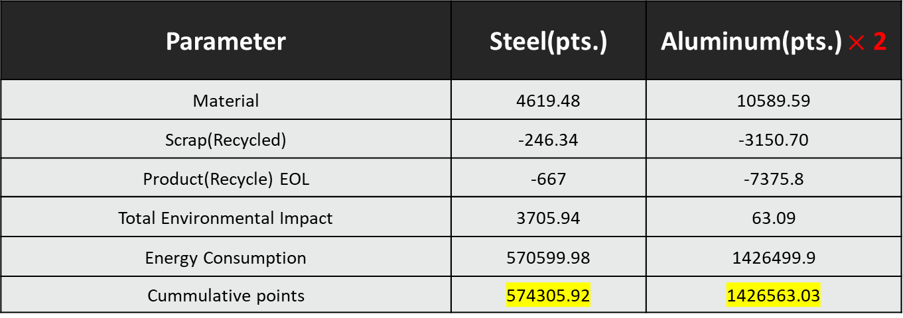
LIFE CYCLE IMPACT ANALYSIS
Case Study : Pressure Cooker Lid
Lecturer: Prof. Paulo Pecas
Parameter | Steel(pts.) | Aluminum(pts.) $×$ 2
Material | 4619.48 | 10589.59
Scrap(Recycled) | -246.34 | -3150.70
Product(Recycle) EOL | -667 | -7375.8
Total Environmental Impact | 3705.94 | 63.09
Energy Consumption | 570599.98 | 1426499.9
Cummulative points | 574305.92 | 1426563.03
TU Chemnitz · Summer Term-2024 · GROUP-4 · Pressure Cooker Lid
LIFE CYCLE ENGINEERING · ADV MANUF
28

Slide 26
FUNCTIONAL ASSESSMENT
Case Study : Pressure Cooker Lid
Lecturer: Prof. Paulo Pecas
Importance | Function | Steel | Aluminum
34% | Thermal conductivity | 3 | 4.5
33% | Corrosion resistance | 5 | 2.5
33% | Weight | 3 | 5
1-5 --> 5 is the best
Normalization | Steel | Aluminium
Thermal conductivity | 67% | 100%
Corrosion resistance | 100% | 50%
Weight | 60% | 100%
Scores |  | Steel | Aluminum
Thermal Conductivity |  | 23% | 34%
Corrosion Resistance |  | 33% | 17%
Weight |  | 20% | 33%
 | Total | 75% | 84%
Aluminum
Steel
TU Chemnitz · Summer Term-2024 · GROUP-4 · Pressure Cooker Lid
LIFE CYCLE ENGINEERING · ADV MANUF
29

Slide 27
USE PHASE ANALYSIS
Case Study : Pressure Cooker Lid
Lecturer: Prof. Paulo Pecas
Use Phase Analysis
 | Alumium Cooker lid | Steel Cooker lid
Duration | 10 years | 20 years
Unitary Cost | € 2.06 | € 0.98
Life Cycle Cost
Duration (years) | Alumium Cooker lid | Steel Cooker lid
Producton phase | € 2.06 | € 0.98
use phase (1st decade) | € - | € -
use phase (2nd decade) | € 2.06 | € -
Total Cost over duration | € 4.11 | € 0.98
TU Chemnitz · Summer Term-2024 · GROUP-4 · Pressure Cooker Lid
LIFE CYCLE ENGINEERING · ADV MANUF
30

Slide 28
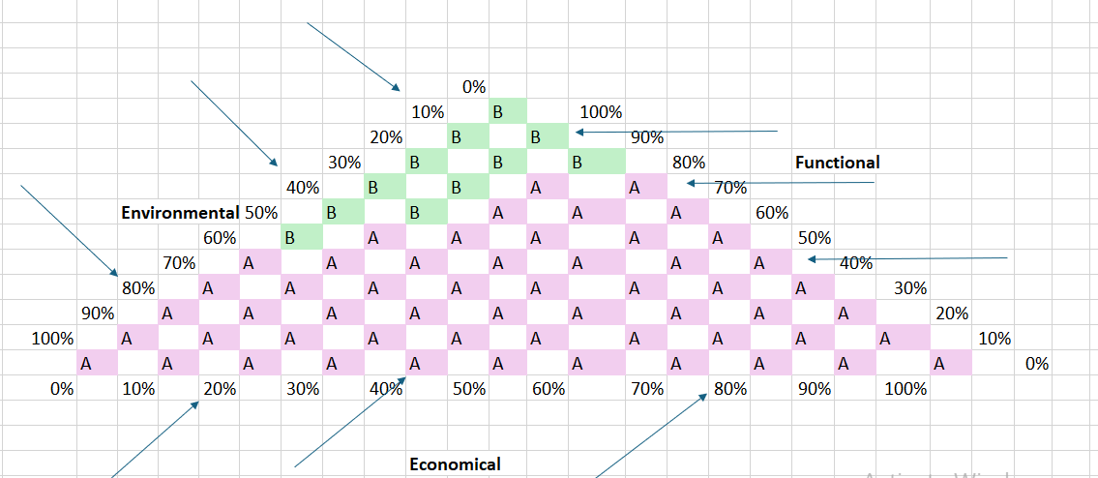
TERNARY DIAGRAM
Case Study : Pressure Cooker Lid
Lecturer: Prof. Paulo Pecas
Steel has best scores for higher importance of Environmental and Economical performance
Aluminum is the best when higher importance is given to Functional performance
Alternatives' Performance | LCC (euros/unit) | LCA (pts/unit) | Functional Assessment
Steel | 0.978 | 0.057 | 7
Aluminum | 4.110 | 0.070 | 9
Normalization of Performance | LCC (euros/unit) | LCA (pts/unit) | Functional Assessment
Steel | 1.00 | 1.00 | 0.78
Aluminum | 0.24 | 0.81 | 1.00
TU Chemnitz · Summer Term-2024 · GROUP-4 · Pressure Cooker Lid
LIFE CYCLE ENGINEERING · ADV MANUF
31

Slide 29
SUMMARY
Case Study : Pressure Cooker Lid
Lecturer: Prof. Paulo Pecas
CONCLUSION
METRIC | STEEL | ALUMINUM
LIFE CYCLE COST (EUROS) | € 98,02,334.74 | € 2,06,25,985.04
LIFE CYCLE IMPACT ANALYSIS (PTS) | 574305.92 | 1426563.03
FUNCTIONAL ANALYSIS (%) | 75% | 84%
Steel has significantly lower life cycle costs compared to aluminium.
The life cycle impact analysis score is much lower for steel than for aluminium, indicating a smaller environmental impact.
Aluminium has a higher functional analysis percentage, suggesting better performance or efficiency compared to steel.
TU Chemnitz · Summer Term-2024 · GROUP-4 · Pressure Cooker Lid
LIFE CYCLE ENGINEERING · ADV MANUF
32

Slide 30
THE END
Case Study : Pressure Cooker Lid
Lecturer: Prof. Paulo Pecas
That’s All Folks
TU Chemnitz · Summer Term-2024 · GROUP-4 · Pressure Cooker Lid
LIFE CYCLE ENGINEERING · ADV MANUF
33

